Slide 1
Air Quality – Machine Learning Project Report
By Anupam Ranjan

Slide 2
Agenda
About the Project
Dataset description
Business questions identified
Hidden insights of the dataset
Approach to the solution
Solution Details
Conclusion

Slide 3
Air Quality – Project Description
Dataset Attributes
Date (DD/MM/YYYY)
Time (HH.MM.SS)
CO Concentration
PT08.S1 (tin oxide)
Non Metanic Hydro Carbons concentration
Benzene concentration
Titania hourly averaged
NOx concentration
Tungsten Oxide concentration
NO2 concentration
Tungsten oxide
Indium oxide
Temperature in °C
Relative Humidity (%) - Target Variable
AH Absolute Humidity
The Dataset
The dataset contains 9358 instances of hourly averaged responses from an array of 5 metal oxide chemical sensors embedded in an Air Quality Chemical Multisensor Device
Ground Truth hourly averaged concentrations for CO, Non Metanic Hydrocarbons, Benzene, Total Nitrogen Oxides (NOx) and Nitrogen Dioxide (NO2) and were provided by a co-located reference certified analyzer.
The objective is to predict the Relative Humidity at a given point of time based on all other attributes affecting the change in RH

Slide 4
Air Quality – Business Questions to be addressed
How good is the quality of data collected? Are there any major discrepancies?
What is the pattern of air quality during the day?
Which factors has +ve relationship with Relative Humidity and which have –ve relation?
What is the monthly pattern of air quality?
How is air quality on a weekday Vs weekend?
Which are the most important features that determine Relative Humidity?
Build a prediction model to forecast Relative Humidity on any given day.

Slide 5
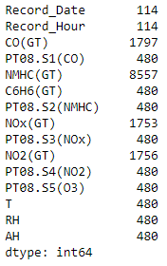
Air Quality – How good is the quality of data collected?
The dataset had 9358 rows. There were considerable NaN values
Strategy for filling NaN values
The CSV file was read replacing -200 with NaN and Date was read as DateTime data type
As the column name Date and Time are python pre defined data types, the column names were changed
As each subsequent row is contiguous date and hours, the best strategy to fill NaN values is to interpolate
Record_Date missing value was filled with Forward Fill method
Missing Values

Slide 6
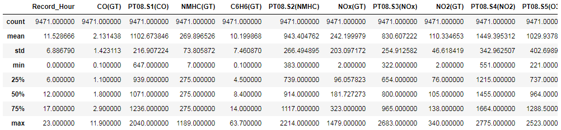
Air Quality – How good is the quality of data collected?
NMHC(GT) has very high max value as compared to mean but IQR values look OK. It appears, there could be outliers
Some of the input variables have very high std deviation but IQR range is OK: CO(GT), C6H6(GT) and NOx(GT). There could be some skewness in the data

Slide 7
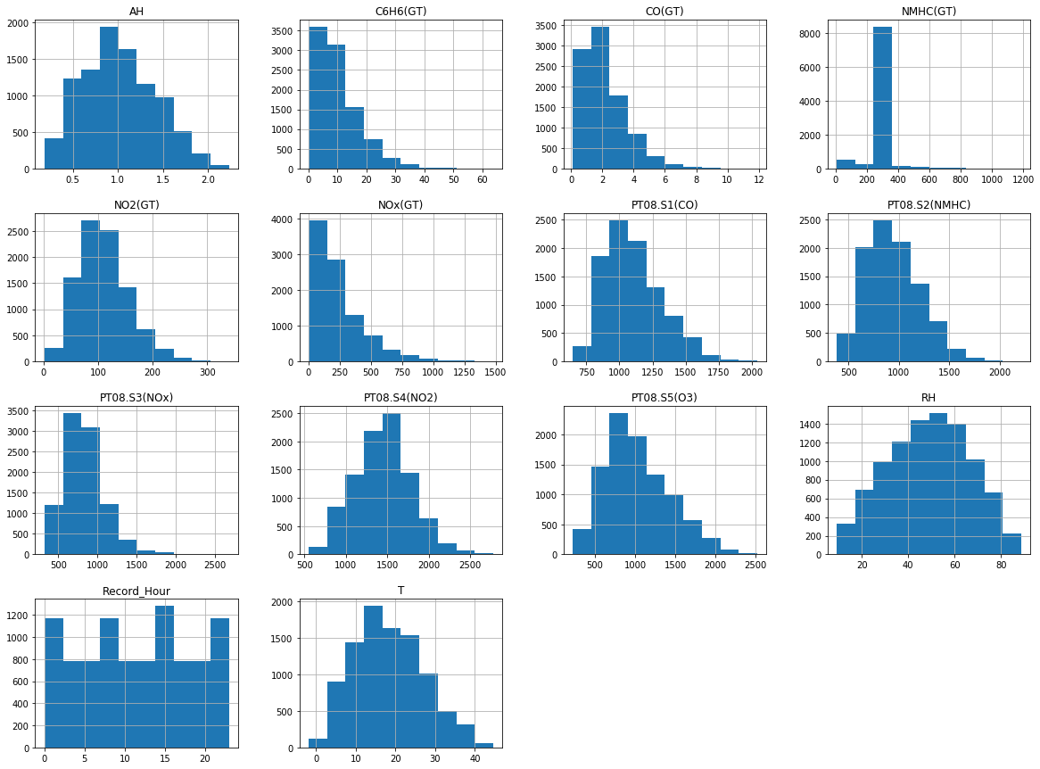
Air Quality – How good is the quality of data collected?

Slide 8
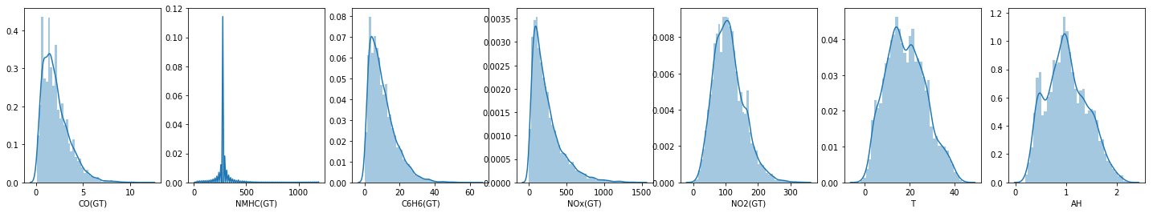
Air Quality – How good is the quality of data collected?
The distribution graph confirms the observation recorded in statistical observation recorded earlier on high standard deviation and skewness

Slide 9
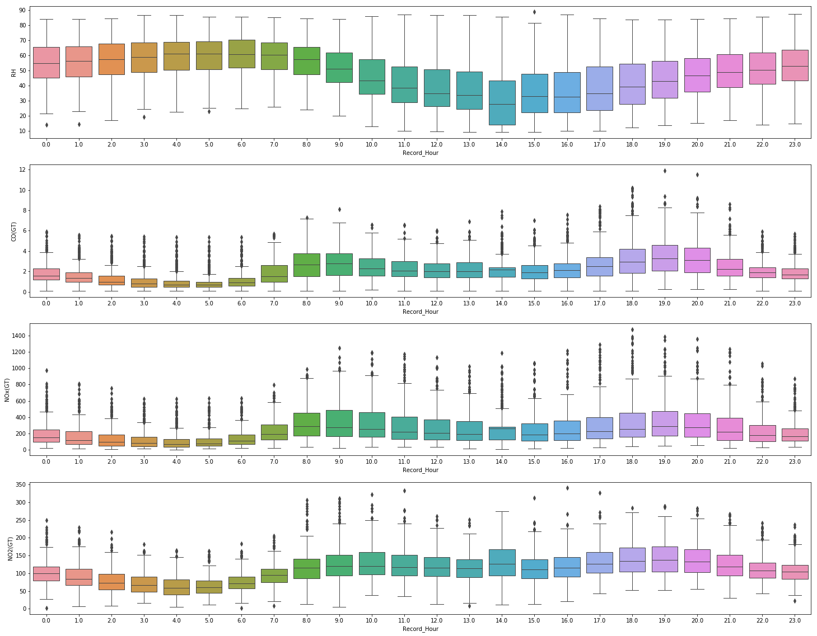
Air Quality – What is the pattern of air quality during the day?
CO(GT), NOx(GT) and NO2(GT) seems to follow similar pattern during the day. They peak during daytime or office hours(8 am to 8 pm)
RH(Output Variable) seems to follow a different pattern during the day, it shows higher values during night(8 pm to 8 am) than daytime

Slide 10
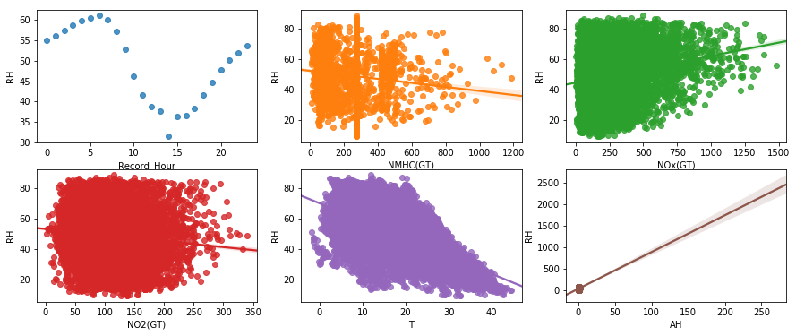
Air Quality – Positive and Negative Factors for Relative Humidity
NOx seems to be positively correlated to RH(o/p variable) whereas temp and NMHC(GT) appear to be -vely correlated with RH
Relative Humidity varies cyclically with Hour of the day

Slide 11
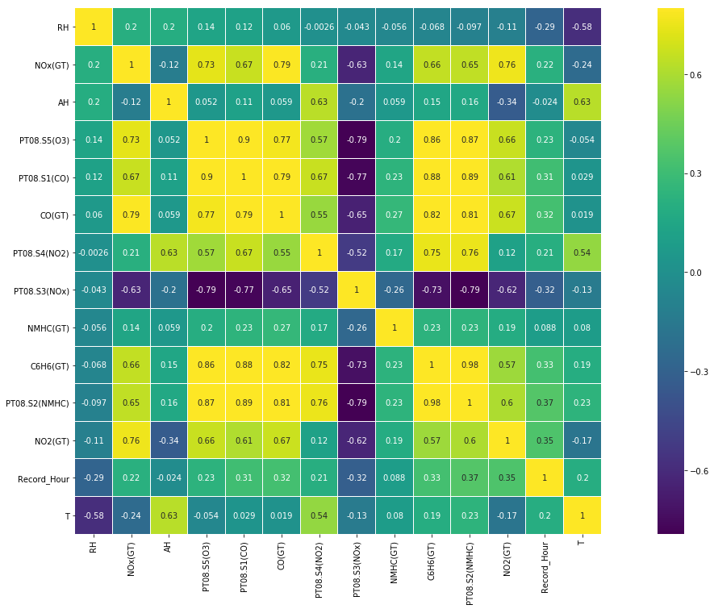
Air Quality – Positive and Negative Factors for Relative Humidity
There are some very high correlated predictor variables. We must clean this up
NOx(GT) is highly correlated with CO(GT), hence, we shall take only 1 of them. Since, NOx(GT) has higher correlation with target variable, we keep it and drop CO(GT)
PT08.S5(O3) is highly correlated with PT08.S1(CO), hence, we shall take only 1 of them. Since, PT08.S5(O3) has higher correlation with target variable, we keep it and drop PT08.S1(CO)
PT08.S5(O3) and CO(GT) are again twins. We have already dropped CO(GT)
PT08.S4(NO2), C6H6(GT) and PT08.S2(NMHC) are triplets. We drop C6H6(GT) and PT08.S2(NMHC)

Slide 12
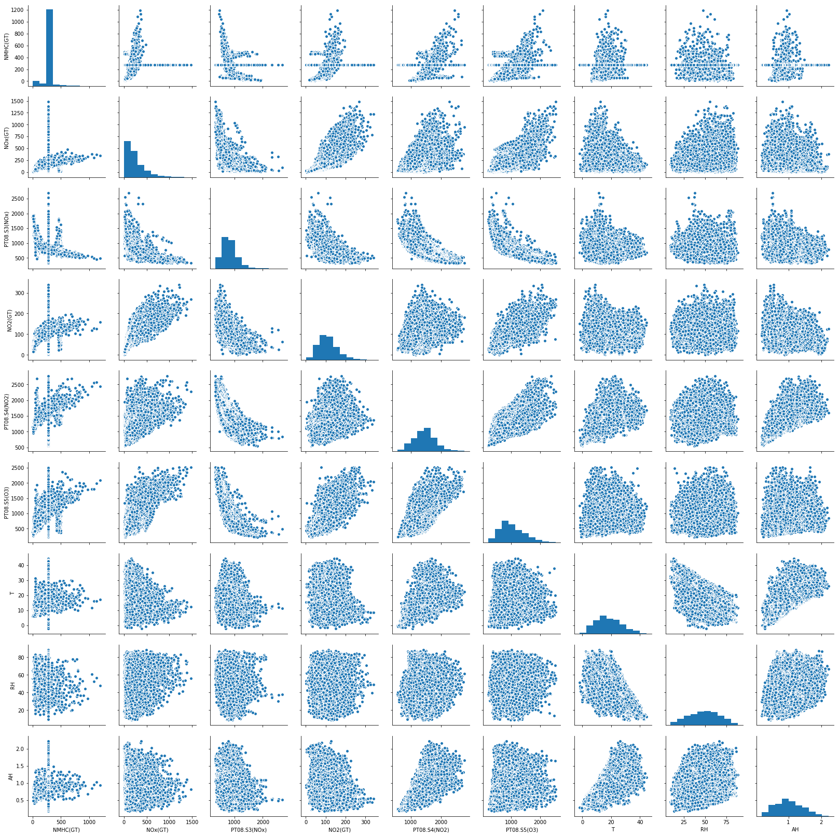
Air Quality – Positive and Negative Factors for Relative Humidity
The Pair Plot shows +ve correlation between some variable, -ve correlation with some variables.
The output variable(RH) does not shows either +ve or -ve correlation with some variables - NO2(GT), PT08.S4(NO2), PT08.S5(O3)

Slide 13
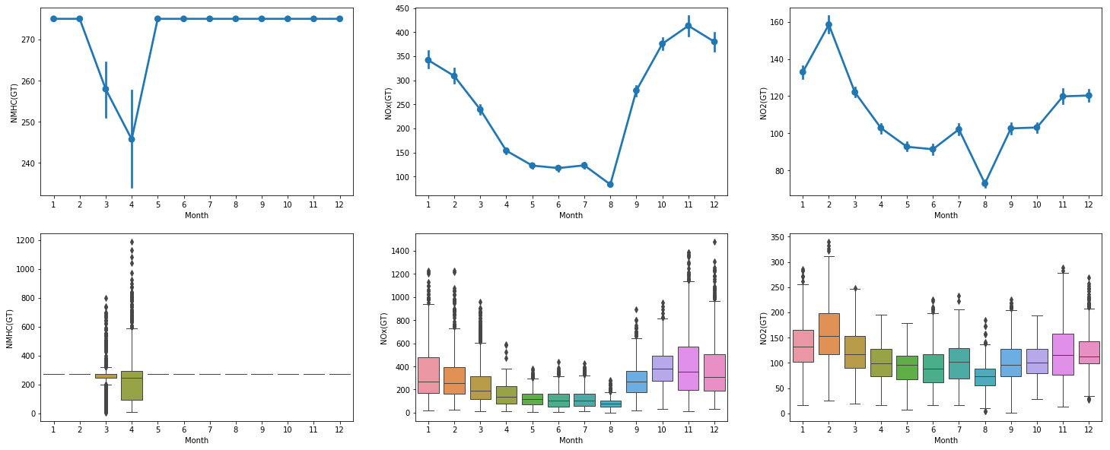
Air Quality – How is the monthly pattern of air quality?

Slide 14
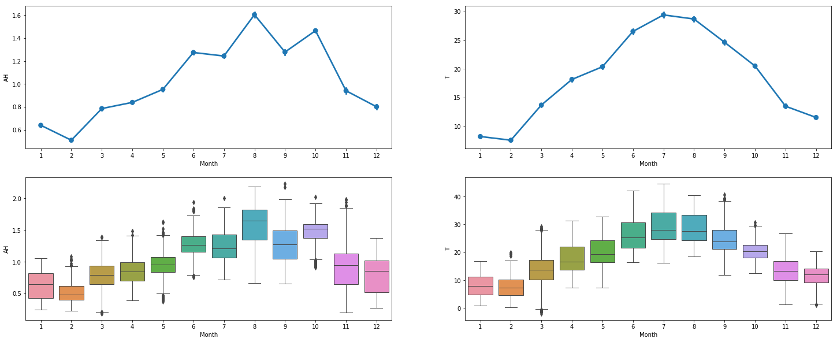
Air Quality – How is the monthly pattern of air quality?
Colder months(September to February) show higher concentration of NOx
NMHC shows sudden dip in level in March and April. For other months, its nearly the same
NO2 shows high value in Jan and Feb compared to other months
Absolute Humidity goes higher during rainy season(June to October) where as the temperature goes higher during summer

Slide 15
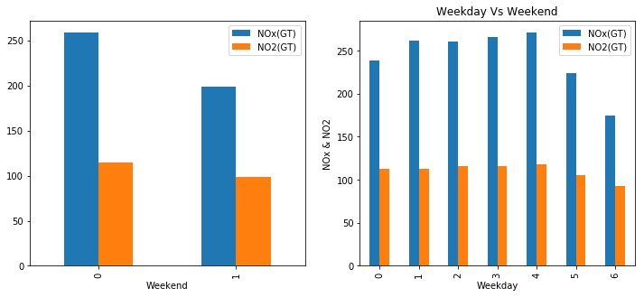
Air Quality – How is air quality on a weekday Vs the weekend?
The NOx and NO2 levels on weekends are considerably lower than on Weekdays
The NOx levels is considerably lower on Monday among weekdays

Slide 16
Model Building

Slide 17
Air Quality – Solution Approach
Different input variable have different ranges, this may lead to bias in the model. We first normalise the data
We then split the dataset into train and test data
We consider 6 different algorithms (Linear Regression, Lasso, Elastic Net, K Nearest Neighbour, Decision Tree/Random Forest and SVM) to find out best performing models
Next we shall reduce dimensionality of the model. We may use Principal Component Analysis(PCA) or Recursive Feature Elimination(RFE). RFE gave a good result, hence, I used RFE
Now, we have best performing model, best performing features and normalised predictor variables. We now do detailed analysis with top 3 algorithms and compare result

Slide 18
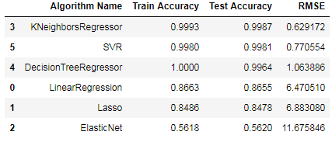
Air Quality – Comparison of Algorithm
The K Nearest Neighbour, SVM and Decision Tree provides best accuracy on test data and lowest RMSE value.
Thus we shall do detailed implementation of these three algorithms – KNN, SVM and Decision Tree and then select our final algorithm

Slide 19
Air Quality – Selecting best predictors variables
Iteration | No of Predictors | Best Predictors | Test Accuracy | RMSE | Adjusted R²
1 | 5 | T, AH, Record_Hour, dNOx, PT08.S4(NO2) | 98.46% | 1.08 | 0.87
2 | 10 | T, AH, Record_Hour, NOx(GT), NO2(GT), PT08.S4(NO2), DateOfMonth, Weekday, dNOx, dNO2 | 99.61% | 1.10 | 0.873
3 | 2 | T, AH | 99.63% | 1.065 | 0.866
4 | 3 | T, AH, Record_Hour | 99.63% | 1.070 | 0.867
5 | 4 | T, AH, Record_Hour, PT08.S4(NO2) | 99.62% | 1.07 | 0.870
Conclusion
The test accuracy is best with 2 features – Temp and Absolute Humidity. It has lowest RMSE and Adjusted R Squared values.
Thus, I go ahead with 2 features for detailed implementation in the 3 algorithms – KNN, SVM and Decision Tree

Slide 20
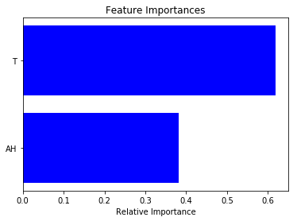
Air Quality – Model Development – Decision Tree/Random Forest
Optimized Grid Search Parameters:
max_depth: 9
min_samples_split: 5
Accuracy
Test Accuracy: 0.9963519859689669
RMSE: 1.065577926789993
Adjusted R Squared: 0.8662557093052974

Slide 21
Air Quality – Model Development – K Nearest Neighbours
Optimized Grid Search Parameters:
n_neighbors: 4
p: 2
Weights: distance
Accuracy
Test Accuracy: 0.9989547290191206
RMSE: 0.5703893557115431
Adjusted R Squared: 0.8662557093052974

Slide 22
Air Quality – Model Development – SVM
Optimized Grid Search Parameters:
gamma : 1
kernel : rbf
Accuracy
Test Accuracy: 0.9982761915411439
RMSE: 0.7324896108613005
Adjusted R Squared: 0.8662557093052974

Slide 23


Air Quality – Model Development – Comparison of 3 Algorithms
Algorithm | Test Accuracy | RMSE | Adjusted R²
Decision Tree/ Random Forest | 0.9963519859689669 | 1.065577926789993 | 0.8662557093052974
KNN | 0.9989547290191206 | 0.5703893557115431 | 0.8662557093052974
SVM | 0.9982761915411439 | 0.7324896108613005 | 0.8662557093052974
Conclusion
KNN provides best accuracy, lowest RMSE value. Thus we choose KNN as our final model.
Test Accuracy: 99.895%
RMSE: 0.57
Adjusted R²: 0.866

Slide 24
Thank You

